Slide 1
Cornell Notes & Memory
Cornell Note Taking Discussion, Storing Data: Bit, Representing and Building Memory, Program Counter Overview

Slide 2
Project 3 Check-in
How has Project 3 been going?
👍 If you’re feeling great about completing Project 2 by tonight
If you’re feeling decent about where you are right now
👎 If you’re feeling behind or unlikely to submit on time
Double-check your submission on GitLab
Navigate to GitLab, open tags, and verify that the associated commit includes your expected changes
Guide for untagging on GitLab on the Ed discussion board
👍

Slide 3
Lecture Outline
Cornell Note Taking Discussion
Compare and Contrast Cornell Notes
Storing Data: Bit
Bit Overview and Implementation
Representing and Building Memory
Array Abstraction, Reading and Writing
Building From the Bit
Program Counter (PC) Overview
Control Flow of Computer Programs

Slide 4
Cornell Note Taking Discussion
In small groups, compare and contrast your Cornell Notes from Tuesday’s lecture
What are some of the key points you wrote in your summary?
What were some of the questions you came up with?
What are you still left feeling confused/uncertain about after Tuesday’s lecture?

Slide 5
Lecture Outline
Cornell Note Taking Discussion
Compare and Contrast Cornell Notes
Storing Data: Bit
Bit Overview and Implementation
Representing and Building Memory
Array Abstraction, Reading and Writing
Building From the Bit
Program Counter (PC) Overview
Control Flow of Computer Programs

Slide 6
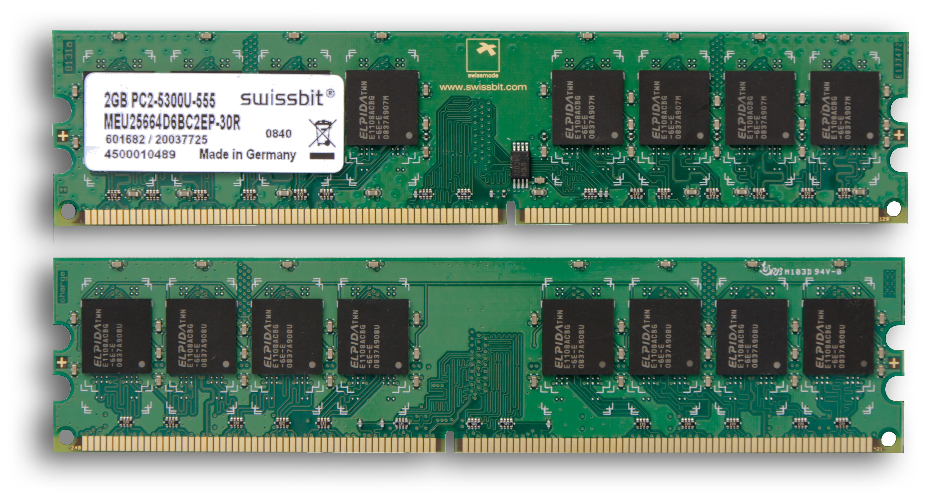
Memory can be though of as which data structure? How is memory similar to this data structure? Different?
Map
Array
Queue
Tree
We’re lost…

Slide 7
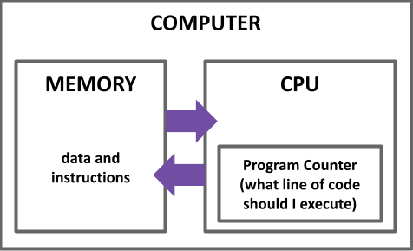
Computer Overview
CPU is the “brain” of our computer
Does necessary computations (add, subtract, multiply, etc.)
Memory is used to store values for later use
Requires persistence across multiple computations
Needs to change values at our discretion

Slide 8
Storing Data: Bit
A Flip-Flop changes state every clock cycle
We will build the abstraction of a “Bit” that only changes when we instruct it to
load
Bit
in
out
if load(t-1) out(t) = in(t-1)
else out(t) = out(t-1)

Slide 9
Bit Behavior
1
load
0
1
in
0
out
1
0
t=0
t=1
t=2
t=3
t=4
load
if load(t-1) out(t) = in(t-1)
else out(t) = out(t-1)
Bit
out
in

Slide 10
Bit Behavior
1
load
0
1
in
0
out
1
0
t=0
t=1
t=2
t=3
t=4
load
if load(t-1) out(t) = in(t-1)
else out(t) = out(t-1)
Bit
out
in

Slide 11
Bit Time Series
if (load(t-1)): out(t) = in(t-1)
else: out(t) = out(t-1)
Bit Specification:
Example 1: load(t=0) == 1 so out(t=1) = in(t=0)
load | 1 | 0 | 0 | 1 | 1 | 1 | 0 | ...
in | 1 | 0 | 0 | 0 | 1 | 0 | 1 | ...
out | 0 | 1 | 1 | 1 | 0 | 1 | 0 | ...
time | t=0 | t=1 | t=2 | t=3 | t=4 | t=5 | t=6 | ...

Slide 12
Bit Time Series
if (load(t-1)): out(t) = in(t-1)
else: out(t) = out(t-1)
Bit Specification:
Example 1: load(t=0) == 1 so out(t=1) = in(t=0)
Example 2: load(t=2) == 0 so out(t=3) = out(t=2)
load | 1 | 0 | 0 | 1 | 1 | 1 | 0 | ...
in | 1 | 0 | 0 | 0 | 1 | 0 | 1 | ...
out | 0 | 1 | 1 | 1 | 0 | 1 | 0 | ...
time | t=0 | t=1 | t=2 | t=3 | t=4 | t=5 | t=6 | ...

Slide 13
Which gates will we need to implement a Bit? Select all that apply.
Mux
Xor
And
DFF
We’re lost…
load
Bit
out
in
if load(t-1) out(t) = in(t-1)
else out(t) = out(t-1)

Slide 14
Implementing a Bit
if load(t-1) out(t) = in(t-1)
else out(t) = out(t-1)
Bit Specification:
Exercise: fill in the connections to the gates to create a circuit diagram of Bit

Slide 15
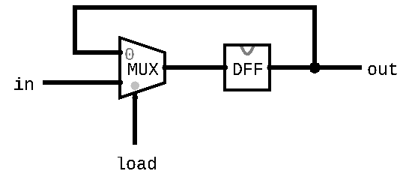
Implementing a Bit
if load(t-1) out(t) = in(t-1)
else out(t) = out(t-1)
Bit Specification:
Exercise: fill in the connections to the gates to create a circuit diagram of Bit

Slide 16
Lecture Outline
Cornell Note Taking Discussion
Compare and Contrast Cornell Notes
Storing Data: Bit
Bit Overview and Implementation
Representing and Building Memory
Array Abstraction, Reading and Writing
Building From the Bit
Program Counter (PC) Overview
Control Flow of Computer Programs

Slide 17
Memory Representation
Memory can be abstracted as one huge array
Addresses are indices into different memory slots
The width of an address is fixed for the system
The nand2tetris project will use 16-bit addresses
Each value in memory takes up a fixed width
Not the same as address width
The nand2tetris project uses 16-bit slots (values) in memory

Slide 18
Memory Representation
Read and write to memory by specifying an address
More details next week
Example: x = memory[01...00]
Reads the value in memory at address 01...00 and stores it in x
Example: memory[01...00] = 7
Writes the value 7 in the memory slot at address 01...00

Slide 19
Five-minute Break!
Feel free to stand up, stretch, use the restroom, drink some water, review your notes, or ask questions
We’ll be back at:
Any song recommendations? Respond on Poll Everywhere at https://pollev.com/cse390b
Research shows mid-lecture breaks reduce the decline of attention in the middle of lecture (Olmsted, 1999)
Olmsted III, John. “The Mid-Lecture Break: When Less Is More.” Journal of Chemical Education (1999). https://pubs.acs.org/doi/abs/10.1021/ed076p525.

Slide 20
Lecture Outline
Cornell Note Taking Discussion
Compare and Contrast Cornell Notes
Storing Data: Bit
Bit Overview and Implementation
Representing and Building Memory
Array Abstraction, Reading and Writing
Building From the Bit
Program Counter (PC) Overview
Control Flow of Computer Programs

Slide 21
Building Memory: Register
Bits store a single value (0 or 1)
In memory, we need to store 16-bit values
Registers are conceptually the same as a Bit
Allows us to store and change 16-bit values
Groups together 16 individual bits that share a load signal
// if (load(t-1)): out(t) = in(t-1)
// else: out(t) = out(t-1)
CHIP Register {
IN in[16], load;
OUT out[16];
...
}

Slide 22
RAM: Random Access Memory
Abstraction of Computer Memory: just a giant array
Goal: create hardware that can provide that abstraction
Key attribute of arrays: “random access” lets us index into them at any point
24 11000 | 25 11001 | 26 11010 | 27 11011 | 28 11100 | 29 11101 | 30 11110 | 31 11111
...
0 0000000 | 0 0000000 | -1 1111111 | 25 0011001 | 124 1111100 | 0 0000000 | 9 0001001 | -15 1110001
...
memory[26] = -1;

Slide 23
Building Memory: RAM8 From Registers
RAM interface:
load: if 1, then in should be written to specified memory slot
in: 16-bit input used to update specified memory slot if load is 1
address: address used to specify memory slot
out: 16-bit output from the slot specified by address
RAM8 can be built from 8 registers
address width is log₂(8) = 3 bits
load
RAM8
in
out
0
Register
16
16
1
Register
address
...
n-1
Register
k

Slide 24
Building Memory: RAM8 From Registers
Step 1: Route in to every register
We don’t want to update every register, however
Solution: choose which register to enable with address
Step 2: Choose which register to use for the output
When we think about making choices in hardware, we want to think about Mux and DMux
load
RAM8
in
out
0
Register
16
16
1
Register
address
...
n-1
Register
k

Slide 25
Building Memory: The Rest of RAM
After RAM8, can build larger RAM chips from a combination of smaller RAM chips
For example, RAM64 can be built using eight RAM8 chips
Technique is similar to RAM8 but will have to use different portions of the address
The blocks section of the reading will be helpful
For example, can think of each RAM8 as a block of RAM64

Slide 26
Lecture Outline
Cornell Note Taking Discussion
Compare and Contrast Cornell Notes
Storing Data: Bit
Bit Overview and Implementation
Representing and Building Memory
Array Abstraction, Reading and Writing
Building From the Bit
Program Counter (PC) Overview
Control Flow of Computer Programs

Slide 27
Program Counter (PC)
Memory is used to store data as well as code
Instructions and operations are stored at different addresses in memory
Program Counter in the CPU keeps track of which address contains the instruction that should be executed next

Slide 28
Program Counter (PC)
Keeps track of what instruction we are executing
If the PC outputs 24, on the next clock cycle the computer runs the instruction at address 24 in the code segment
Program counter specification:
if (reset[t] == 1) out[t+1] = 0
else if (load[t] == 1) out[t+1] = in[t]
else if (inc[t] == 1) out[t+1] = out[t] + 1
else out[t+1] = out[t]
load
inc
reset
in
PC
out
16
16

Slide 29
Project 4 Overview
Part I: Cornell Note Taking
Practice taking detailed notes in another class
Think critically about the technique
Part II: Building Memory
Memory & Sequential Logic: Build our first sequential chips, from a 1-bit register to a 16K RAM module
Program Counter: Build counter that tracks where we are in a program, with support for several operations we’ll need later
Note: Folder split for performance reasons only
Part III: Project 4 Reflection

Slide 30
Lecture 6 Wrap-up
Stoked for these subjects lined up for Week 4!
Metacognitive Subject: Annotation Strategies
Technical Subject: Machine Languages and Hack Assembly
Project Reminders:
Project 3 due tonight (Thursday, 4/14) at 11:59pm PDT
Project 4 (Cornell Note Taking & Building Memory) released, due next Thursday (4/21) at 11:59pm PDT
Late days from Project 2 and before are updated on Canvas

